Slide 1
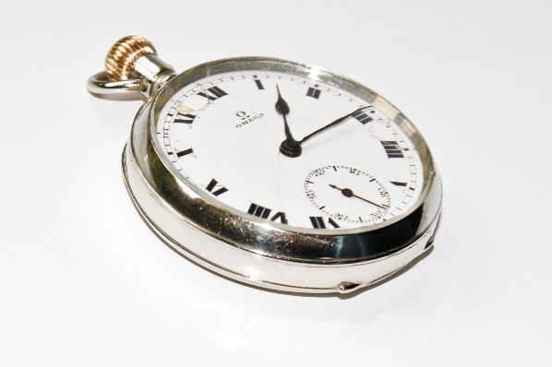
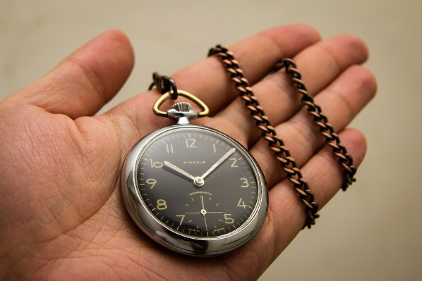
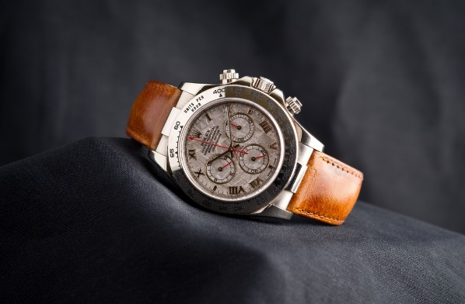
Watch Timeline
1800
Event
1900
1950
Event
2000
2005
Descrpition
Descrpition
Image Explanation -replace
Image Explanation -replace
Image Explanation -replace

